Slide 1


MOLLETI CHIRU VISHAL
26-2-2002

Slide 2

Outline
Executive Summary
Introduction
Methodology
Results
Conclusion
Appendix

Slide 3
Executive Summary
Data was analysed using the following methodologies:
1)Machine Learning Prediction.
2)Exploratory Data Analysis (EDA), including data wrangling, data visualization and interactive visual analytics;
3)Data Collection using web scraping and SpaceX API;
Summary of all results
1)Using the collected data, Machine Learning Prediction demonstrated the best model for predicting which attributes are necessary to drive this opportunity.
2)EDA enabled the identification of which features best predict the success of launches.
3) It was possible to collected valuable data from public sources;

Slide 4
Introduction
The goal is to assess the viability of the new firm Space Y in competing with Space X.
Desirable answers:
1)The best technique to estimate total launch costs is to predict successful first-stage rocket landings.
2)Where is the best place to make launches.

Slide 5

Section 1

Slide 6
Methodology
Executive Summary
Data collection methodology:
Data from Space X was obtained from 2 sources:
• Space X API (https://api.spacexdata.com/v4/rockets/) • WebScraping
(https://en.wikipedia.org/wiki/List_of_Falcon/_9/_and_Falcon_Heavy_launches)
Perform data wrangling
• Collected data was enriched by creating a landing outcome label based on outcome data after summarizing and analyzing features

Slide 7
Methodology
Perform exploratory data analysis (EDA) using visualization and SQL
Perform interactive visual analytics using Folium and Plotly Dash
Perform predictive analysis using classification models
Data acquired up to this point were normalised, divided into training and test data sets, and evaluated by four different classification models, with the accuracy of each model evaluated using different parameter combinations.

Slide 8
Data Collection
Data sets were collected from Space X API (https://api.spacexdata.com/v4/rockets/) and from Wikipedia (https://en.wikipedia.org/wiki/List_of_Falcon/_9/_and_Falcon_Heavy_launches), using web scraping technics.

Slide 9
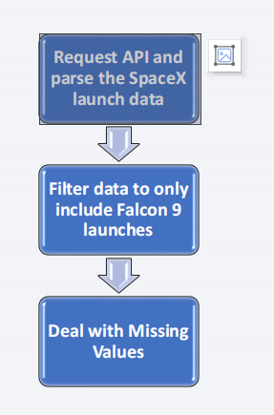
– SpaceX API
SpaceX provides a public API through which data may be downloaded and used.
This API was used according to the flowchart beside and then data is persisted.
Source Code : https://github.com/chiruvishal/Datascience/blob/main/Spacex.ipynb

Slide 10
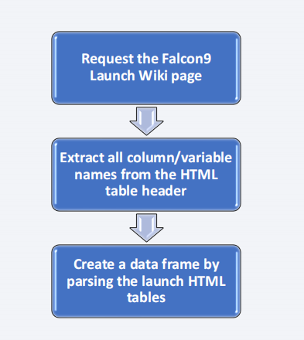
Data Collection - Scraping
Data from SpaceX launches can also be obtained from Wikipedia;
According to the flowchart, data is downloaded from Wikipedia and then persisted.
Source Code- https://github.com/chiruvishal/Datascience/blob/main/Web%20Scraping.ipynb

Slide 11
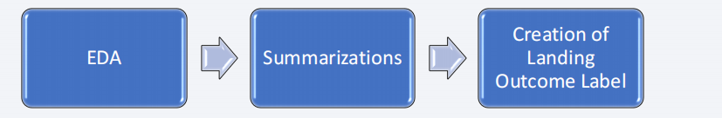
Data Wrangling
The dataset was first subjected to some exploratory data analysis (EDA). The sums of launches per site, occurrences of each orbit, and occurrences of mission outcome per orbit type were then computed. Finally, the Outcome column was used to generate the landing outcome label.
Source Code- https://github.com/chiruvishal/Datascience/blob/main/Data%20Wrangling.ipynb

Slide 12
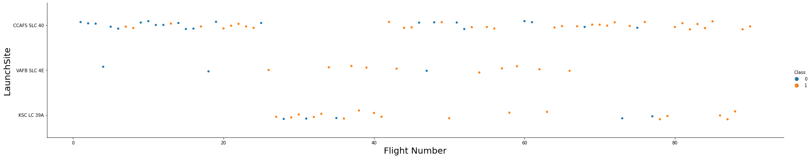
EDA with Data Visualization
Scatterplots and barplots were used to visualise the relationship between two features when exploring data.Payload Mass X Flight Number, Launch Site X Flight Number, Launch Site X Payload Mass, Orbit and Flight Number, Payload and Orbit.
Source Code- https://github.com/chiruvishal/Datascience/blob/main/Exploratory%20Analysis%20using%20matplotlib.ipynb

Slide 13
EDA with SQL
The following SQL queries were performed:
• Names of the unique launch sites in the space mission;
• Top 5 launch sites whose name begin with the string 'CCA’;
• Total payload mass carried by boosters launched by NASA (CRS);
• Average payload mass carried by booster version F9 v1.1;
• Date when the first successful landing outcome in ground pad was achieved;
• Names of the boosters which have success in drone ship and have payload mass between 4000 and 6000 kg;
• Total number of successful and failure mission outcomes;
• Names of the booster versions which have carried the maximum payload mass;
• Failed landing outcomes in drone ship, their booster versions, and launch site names for in year 2015; and
• Rank of the count of landing outcomes (such as Failure (drone ship) or Success (ground pad)) between the date 2010-06-04 and 2017-03-20.
source code- https://github.com/chiruvishal/Datascience/blob/main/Exploratory%20Analysis%20(1).ipynb

Slide 14
Build an Interactive Map with Folium
Folium Maps were utilised with markers, circles, lines, and marker clusters. Markers represent points, such as launch sites; Circles represent highlighted areas around specific coordinates, such as NASA Johnson Space Center; Marker clusters represent groups of events in each coordinate, such as launches at a launch site; and Lines represent distances between two coordinates.
Source Code- https://github.com/chiruvishal/Datascience/blob/main/Interactive%20Visual%20Analytics%20with%20Folium%20lab.ipynb

Slide 15
Build a Dashboard with Plotly Dash
The graphs and plots shown below were used to visualise data:
• Payload range • Percentage of launches by site .
This combination allows for a fast analysis of the relationship between payloads and launch locations, assisting in determining the optimum spot to launch based on payloads.
Source Code- https://github.com/chiruvishal/Datascience/blob/main/DashboardwithPlotly.py

Slide 16
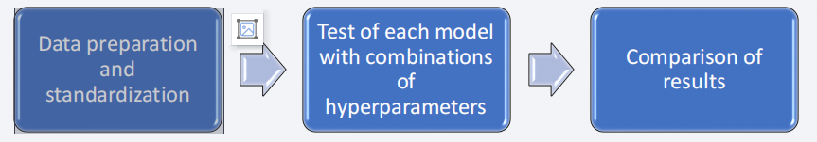
Predictive Analysis (Classification)
• Four classification models were compared: logistic regression, support vector machine, decision tree and k nearest neighbors.
Source Code- https://github.com/chiruvishal/Datascience/blob/main/Machine%20Learning%20Prediction.ipynb

Slide 17
Results
Exploratory data analysis results:
1) Space X uses 4 different launch sites;
2) The first launches were done to Space X itself and NASA;
3)The average payload of F9 v1.1 booster is 2,928 kg;
4)The first success landing outcome happened in 2015 fiver year after the first launch;
5)Many Falcon 9 booster versions were successful at landing in drone ships having payload above the average;
6)Almost 100% of mission outcomes were successful;
7)Two booster versions failed at landing in drone ships in 2015: F9 v1.1 B1012 and F9 v1.1 B1015;
8) The number of landing outcomes became as better as years passed.

Slide 18
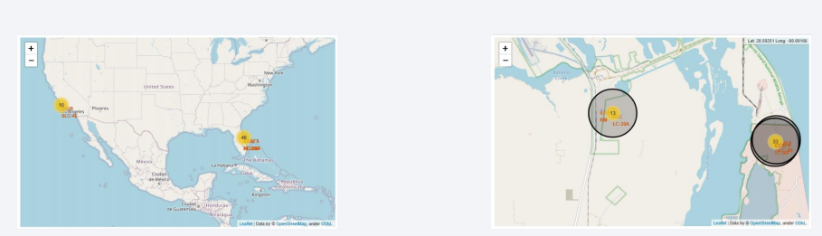
Results
Using interactive analytics, it was possible to determine that launch sites used to be in safe locations, such as near the sea, and had a good logistic infrastructure surrounding them.

Slide 19
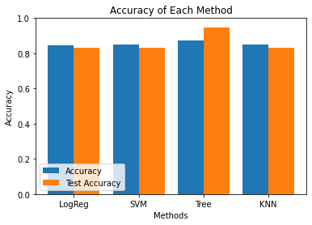
Results
Predictive Analysis showed that Decision Tree Classifier is the best model to predict successful landings, having accuracy over 87% and accuracy for test data over 94%.

Slide 20

Section 2

Slide 21
Flight Number vs. Launch Site
According to the plot above, the best launch site nowadays is CCAF5 SLC 40, where the majority of recent launches were successful.
In second place VAFB SLC 4E and third place KSC LC 39A, It’s also possible to see that the general success rate improved over time

Slide 22
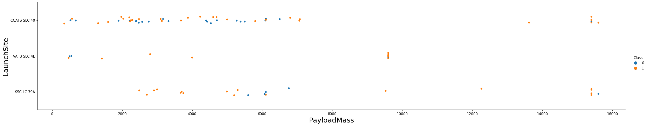
Payload vs. Launch Site
Payloads weighing more over 9,000kg (about the weight of a school bus) have a high success rate.
Payloads weighing more than 12,000kg appear to be limited to the CCAFS SLC 40 and KSC LC 39A launch sites.

Slide 23
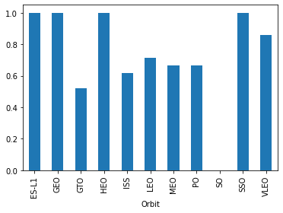
Success Rate vs. Orbit Type
The biggest success rates happens to orbits:
• ES-L1;
• GEO;
• HEO; and
• SSO.
Followed by:
• VLEO (above 80%); and
• LFO (above 70%).

Slide 24
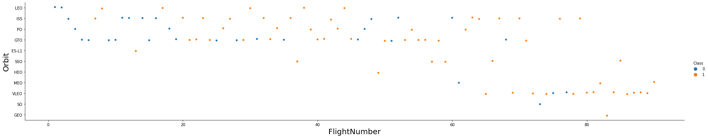
Flight Number vs. Orbit Type
Although the success rate for all orbits appears to have improved over time, the VLEO orbit appears to be a new business opportunity due to the recent increase in its frequency.

Slide 25
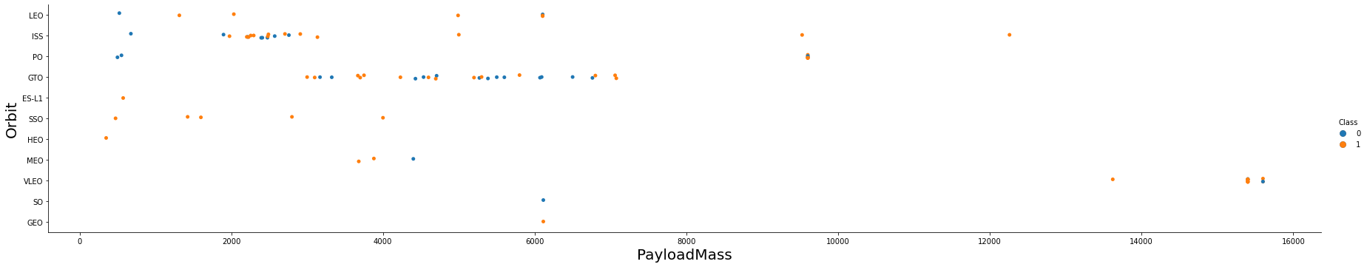
Payload vs. Orbit Type
Apparently, there is no relation between payload and success rate to orbit GTO;
• ISS orbit has the widest range of payload and a good rate of success;
• There are few launches to the orbits SO and GEO.

Slide 26
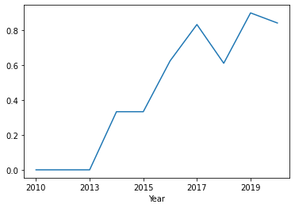
Launch Success Yearly Trend
The success rate began to rise in 2013 and will continue to rise until 2020. It appears that the first three years were a period of technological adjustment and advancement.

Slide 27
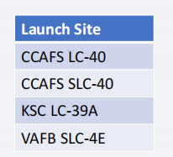
All Launch Site Names
According to data, there are four launch sites:
They are obtained by selecting unique occurrences of “launch_site” values from the dataset.

Slide 28
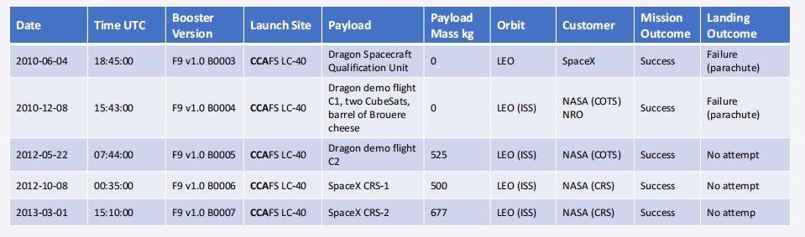
Launch Site Names Begin with 'CCA'
5 records where launch sites begin with `CCA`:
Present your query result with a short explanation here

Slide 29
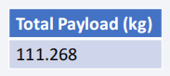
Total Payload Mass
Total payload carried by boosters from NASA:
Total payload calculated above, by summing all payloads whose codes contain ‘CRS’, which corresponds to NASA.

Slide 30
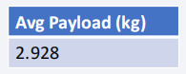
Average Payload Mass by F9 v1.1
Average payload mass carried by booster version F9 v1.1:
Filtering data by the booster version above and calculating the average payload mass we obtained the value of 2,928 kg.

Slide 31
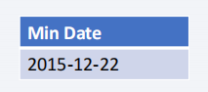
First Successful Ground Landing Date
First successful landing outcome on ground pad:
By filtering data by successful landing outcome on ground pad and obtaining the minimum value for date, the first occurrence, which occurred on 12/22/2015, can be identified.

Slide 32
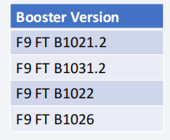
Successful Drone Ship Landing with Payload between 4000 and 6000
Boosters that successfully landed on a drone ship with a payload mass greater than 4000 but less than 6000.
These four booster versions were selected using the filters listed above.

Slide 33
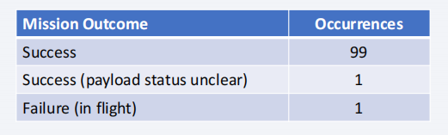
Total Number of Successful and Failure Mission Outcomes
Number of successful and failure mission outcomes:
We arrived at the summary above by grouping mission outcomes and counting records for each group.

Slide 34
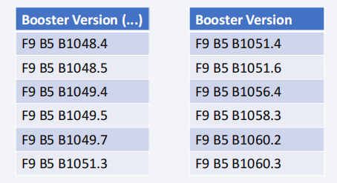
Boosters Carried Maximum Payload
Boosters which have carried the maximum payload mass
These are the boosters that have transported the most payload mass in the dataset.

Slide 35
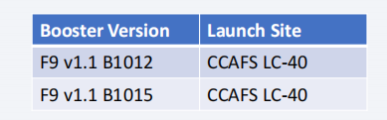
2015 Launch Records
In 2015, failed landing results in drone ships, their booster variants, and launch site names
The list above has the only two occurrences

Slide 36
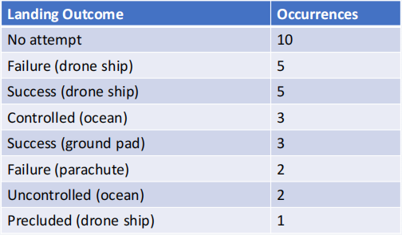
Rank Landing Outcomes Between 2010-06-04 and 2017-03-20
Ranking of all landing outcomes between the date 2010-06-04 and 2017-03-20:
This view of data alerts us that “No attempt” must be taken in account

Slide 37

Section 3

Slide 38
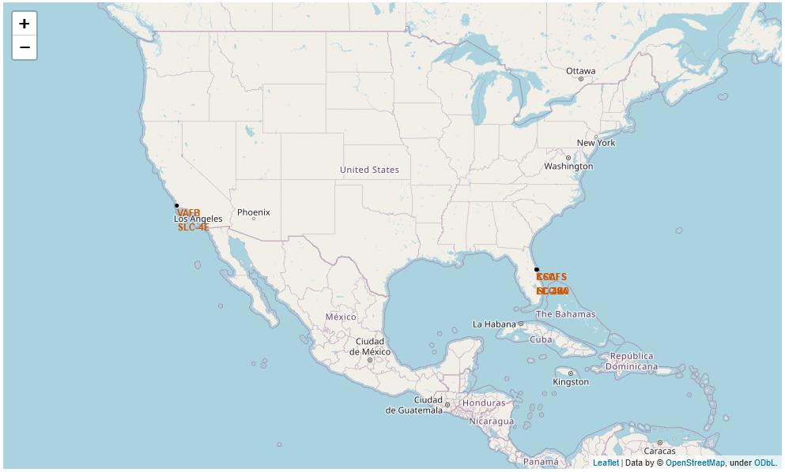
All launch sites
Launch sites are near sea, probably by safety, but not too far from roads and
railroads.

Slide 39
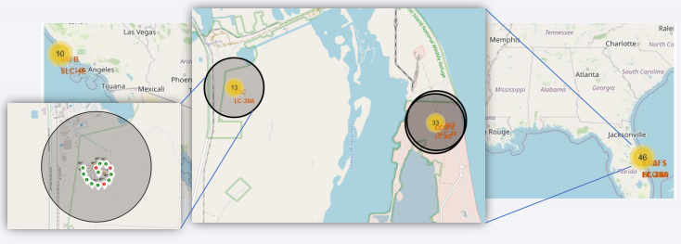
Launch Outcomes by Site
Example of KSC LC-39A launch site launch outcomes, Green markers indicate successful and red ones indicate failure.

Slide 40
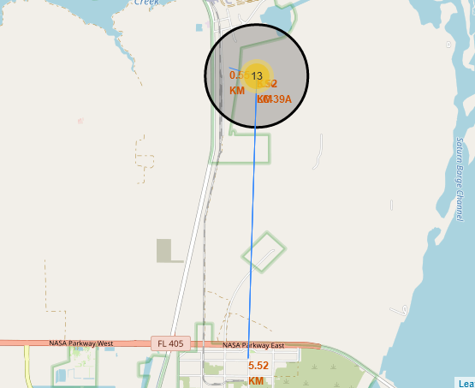
Logistics and Safety
Launch site KSC LC-39A has good logistics aspects, being near railroad and road and
relatively far from inhabited areas.

Slide 41

Section 4

Slide 42
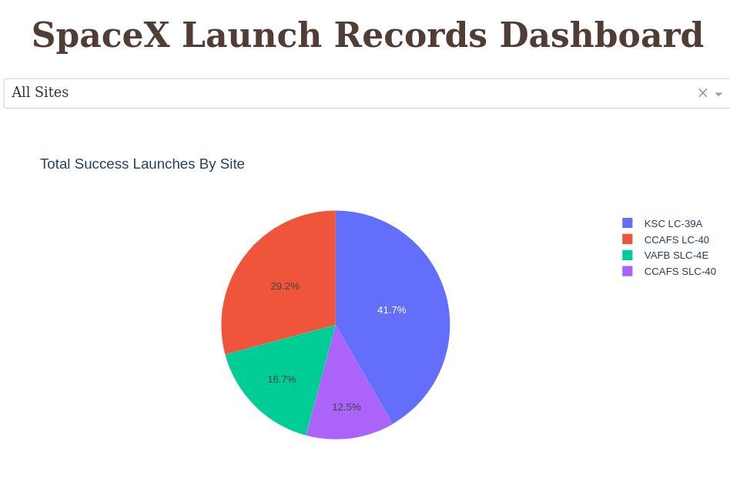
Successful Launches by Site
The location of mission launches appears to be a critical determinant in mission success.

Slide 43
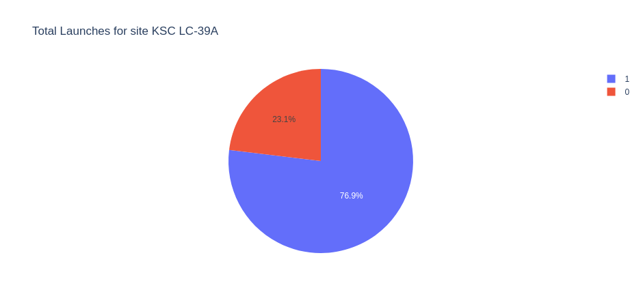
Launch Success Ratio for KSC LC-39A
76.9% of launches are successful in this site.

Slide 44
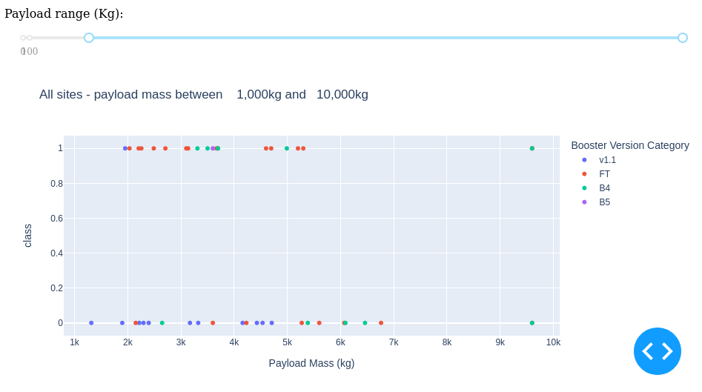
Payload vs. Launch Outcome
The most successful combination is payloads under 6,000 kg and FT boosters.

Slide 45

Section 5

Slide 46
Classification Accuracy
Four classification models were tested, and their accuracies are plotted beside;
The model with the highest classification accuracy is Decision Tree Classifier, which has accuracies over than 87%

Slide 47
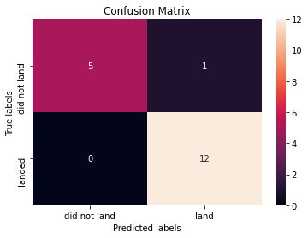
Confusion Matrix
The Decision Tree Classifier's confusion matrix demonstrates its accuracy by displaying a large number of true positive and true negative results compared to false results.

Slide 48
Conclusions
Profits can be increased by using Decision Tree Classifier to predict successful landings.
Although the majority of mission outcomes are successful, successful landing outcomes appear to improve over time as processes and rockets evolve.
Different data sources were analyzed, refining conclusions along the process;
The best launch site is KSC LC-39A . Launches above 7,000kg are less risky;

Slide 49
Appendix
As an improvement for model tests, it’s important to set a value to
np.random.seed variable;

Slide 50


